Slide 1
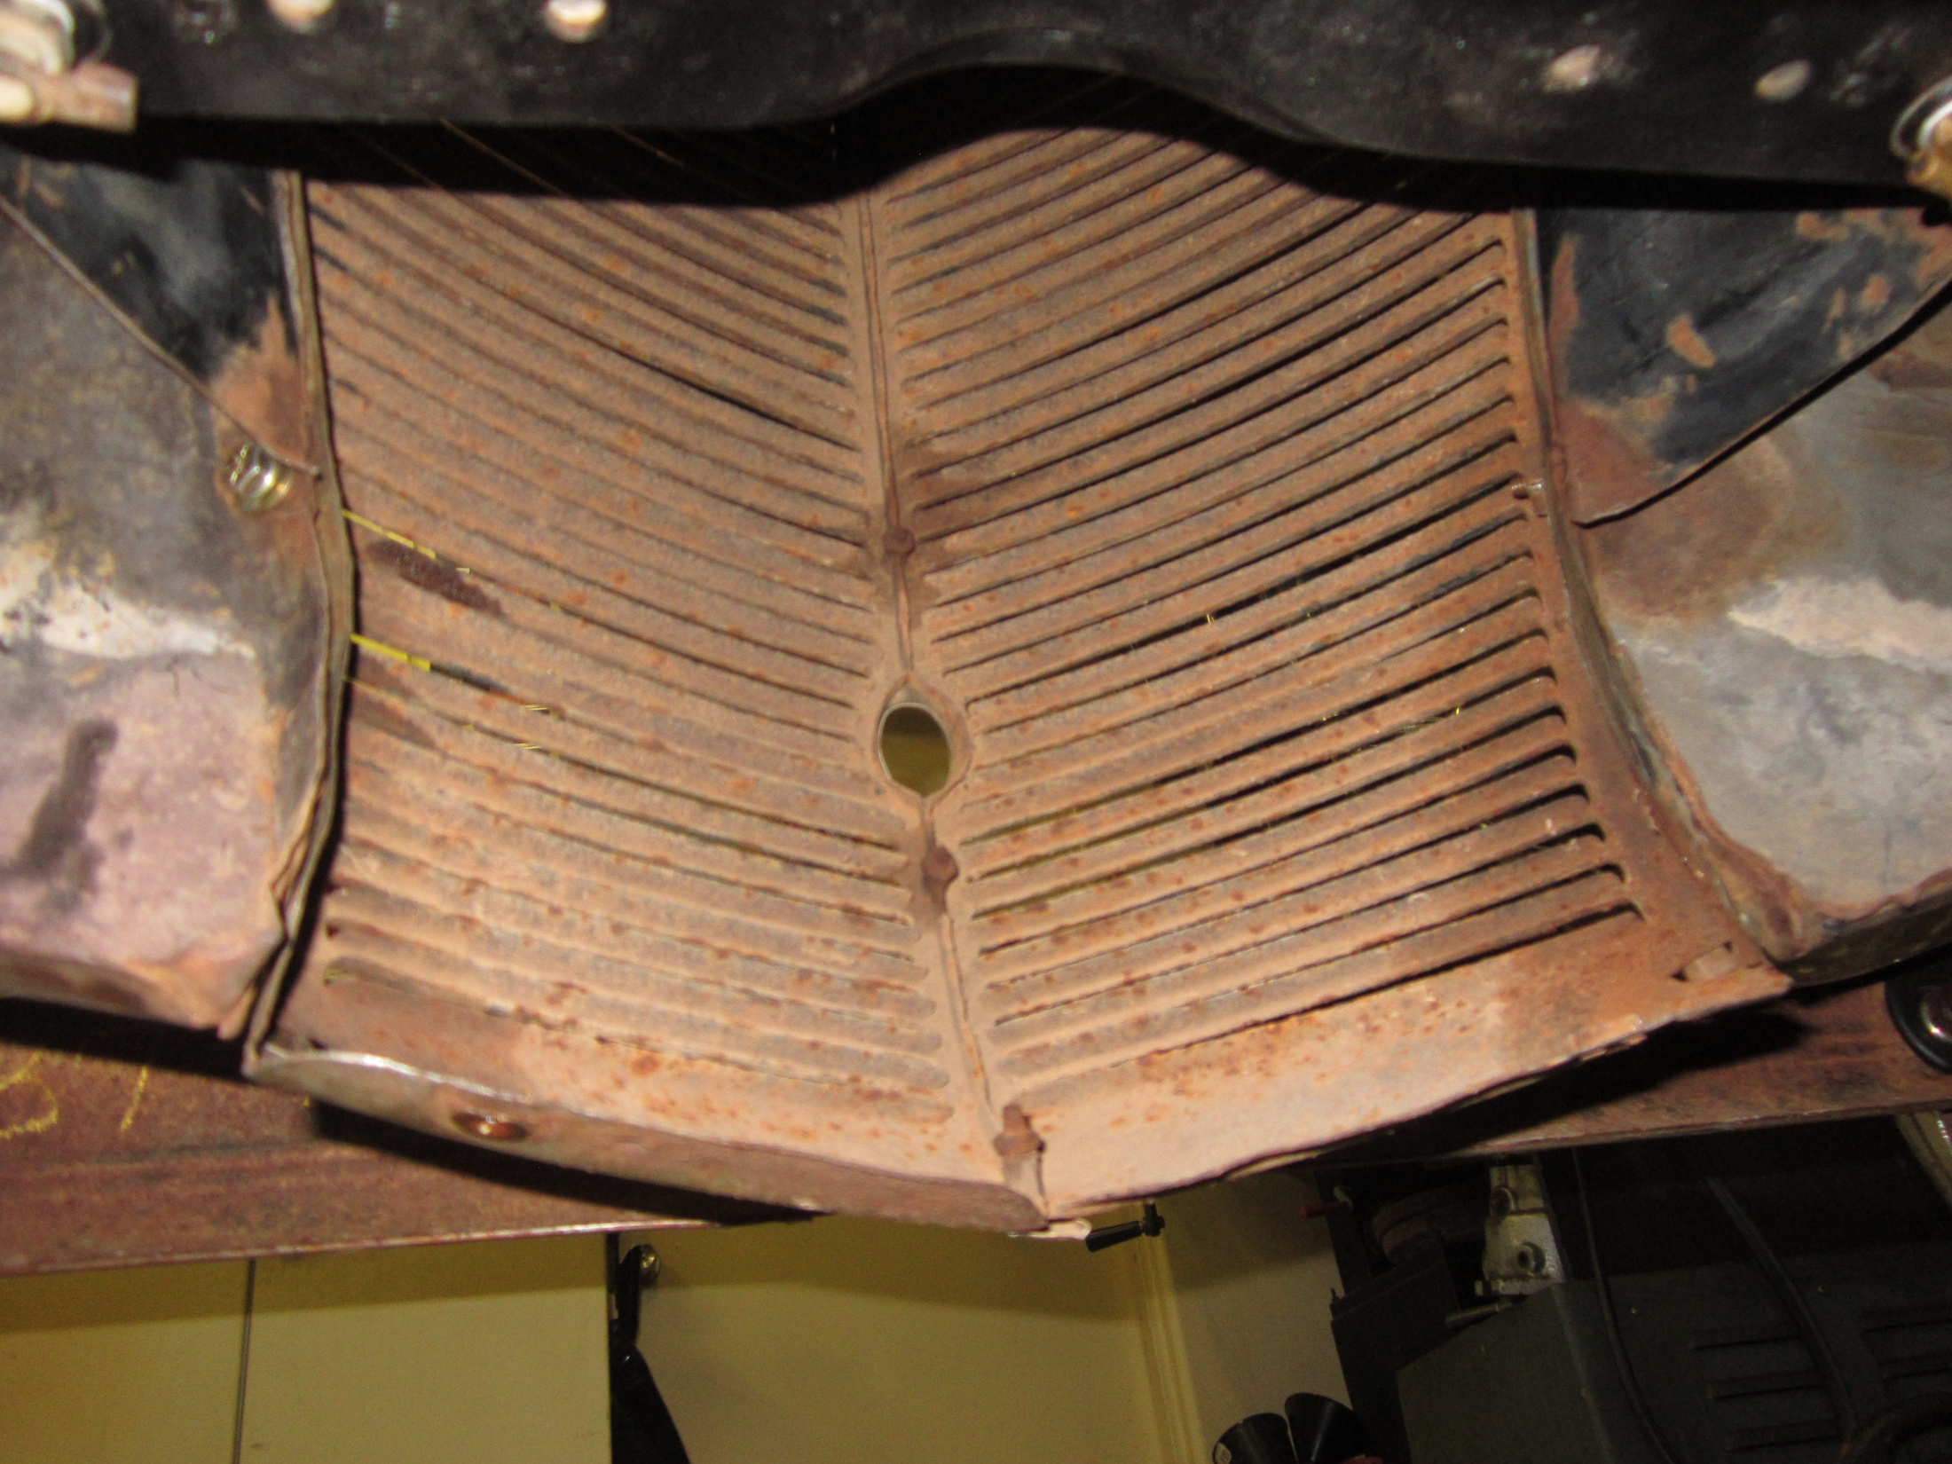
Outside mount
Inside mount

